Slide 1
Organ, Tissue & Eye Donation
LifeSource Ambassador
Notes:
Remember: Your ultimate goal is to INSPIRE your audience to register. ​
​
Introduce yourself as a LifeSource Donate Life Ambassador. “LifeSource is the non-profit organization that manages the organ donation process for Minnesota, North Dakota, South Dakota and western Wisconsin.”
You are here to talk to the students about organ, eye and tissue donation and what it means to register as a donor so that they have the facts and can make the decision that is right for them when they go to get their permit/license.​
​
​
Optional: Ask for a show of hands of anyone who has a connection to donation or transplantation and ask them to briefly share that connection. ​

Slide 2
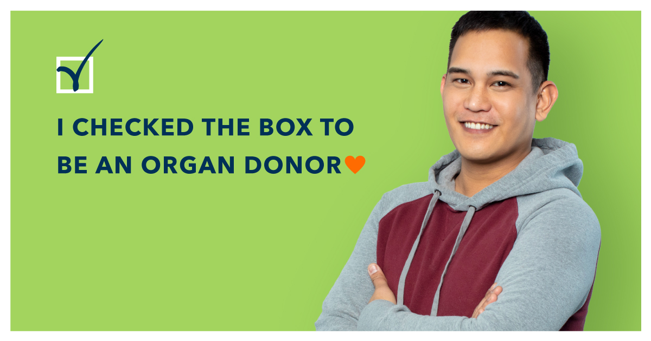
Making YOUR decision about organ donation
Notes:
Transition to begin the presentation:
Suggested comment for this slide: “Let’s get into talking about why donation is so important and share some facts so that you can make an informed decision about registering as a donor”

Slide 3
The need
100,000+
people are waiting for a transplant
More than 100,000 men, women and children in the U.S. are waiting for life-saving organ transplants and more than 2,700 live in the Upper Midwest.
When you designate your decision to be a donor, you are authorizing donation to occur after death.
Register to be a donor at life-source.org
57%
of all adults in MN, ND and SD are registered donors
Anna, Organ Recipient
Coyle, Organ Recipient
Karishma, Organ Recipient
Notes:
Transition slide to ground the audience before moving into your story.
The #1 reason why donation is so important. There are more people waiting for a life-saving organ transplant than there are organs available.
Approx. 100, 000 individuals waiting for an organ transplant to save their life in the United States, with about 3000 of those in our community (MN, ND and SD).
(Note: the photos shown in this slide are of local organ recipients who are now thriving).
One donor could potentially save and heal more than 75 lives through organ, eye and tissue donation (8 organs, countless tissue grafts, corneas)

Slide 4
My Story
Notes:
Let me tell you why donation is so important to me personally….
Share your story in 5-7 minutes. Add photos and more slides, if you would like. Or just talk.
Key points to cover for Recipients:​
What life was like for you before and leading up to transplant? Thoughts and feelings when told you needed to be listed for transplant?
Avoid sharing too much medical information, medications, dates. Instead, focus on painting a picture of what life was like for you.
Receiving “the call”
What it was like to find out that there was an organ available for you​?
Life after transplant​
What you are able to do now because of transplant (e.g., watch kids grow-up, back to school/work, travel, play golf, etc.)
Gratitude for donor​
Share general info about your donor, if known (e.g., my donor was a 45-year-old father of two from the Midwest who is a hero) or just gratitude for donors in general. Remember confidentiality.
Key points to cover for Donor Family:
​Introduce and share some information about your loved one:
hobbies, interests, personality​
The situation that led to your loved one being a donor
General overview (e.g., on May 12, 2019, our dear Johnny was in a car accident). Feel free to keep it as vague as you would like.
Did you know your loved one’s decision or thoughts on donation before their passing​?
What organs, tissues, cornea your loved one was able to donate
Impact of donation on you and your family​ and the legacy of your loved one
Provide a brief overview of what donation has meant to you and your family, how you honor your loved one’s legacy, etc.
Recipient info. Have you heard from or met any recipients? Remember confidentiality.

Slide 5
What can be donated?
Cornea, Sclera
Lungs
Heart Valves
Heart
Bone Marrow
Pancreas
Bone
Liver
Skin
Kidneys
Veins
Intestines
Connective Tissue
You can donate...
Organs (Blue)
Tissue (Orange)
Tendons
Notes:
The Organs and tissues (eyes) that can be donated after death and are needed for transplant.
This slide is set-up so that each individual click will reveal the name of the organ or tissue that coincides with the icon. For example, when you go to this slide in presenter mode, only the organ icons will show up at first. Click once and the word Lungs will appear. Click again and Heart is revealed. And, so on
*Option: Before showing this chart, you can ask the audience what organs and tissues they thinks can be donated after death and are needed for transplant and generate a list to compare to the chart.
Note regarding bone marrow – this is not the same as bone marrow that is donated for treatment of cancer and other illnesses; that type of bone marrow donation needs to come from a living donor. Bone marrow donation after death is used along with donated bone to aid in the healing after transplantation.

Slide 6
Top 10 facts about donation
Your life is always first
Everyone has the potential to be a donor
All major religions support donation
There is no cost to the donor’s family
One individual can save and heal more than 75 lives
Notes:
The following two slides are the top 10 facts about donation/FAQ’s about donation. Explanation of each fact:
The hospital and EMT’s number one priority is to save your life. Your status as a donor is not considered until every effort has been made to save your life. Also, the teams involved in trying to save your life have nothing to do with the donation/transplant process.
Anyone can register to be a donor! Age or health should not prevent you from registering as a donor. The medical professionals will determine if your organ, eyes or tissues are healthy enough to be donated at the time of death.
All major religions in the U.S. support donation and consider it a generous act of caring. With that said, we always encourage people to talk to their faith leader with more questions
Donor families will have no expenses associated with donation
One donor can potentially save and heal up to 75 lives (or more!) through organ, eye and tissue donation.

Slide 7
Top 10 facts about donation
6. Everyone is equal on the transplant waiting list
7. Your decision will be honored
8. If you don’t make a decision, your family will
9. Donors are treated with care and respect
10. Registering is easy!
Notes:
6. Organs are allocated based on medical factors such as blood type, body size, severity of illness and length of time on the wait list. Nobody receives priority based on wealth or influence.
7. Registering to be a donor is legal and binding for ages 18 & over. Your decision to be a donor will be honored. Under age 18 – parent/guardian makes ultimate decision.
8. If you have not registered to be a donor, your family will be asked to make the decision (for any age).
9. Donors are treated with the utmost respect and viewed as heroes. Donation does not prevent an open-casket funeral or any type of viewing.
10. You can register online (life-source.org or registerme.org), at the DMV, on your iPhone app, and on your hunting and fishing license in MN.

Slide 8
Donor Designation
Make your decision
Document your decision
Share your decision
Notes:
Donor Designation is legal and binding for ages 18 and over. Under the age of 18 – parent or legal guardian will make the decision, regardless of donor designation.
In the case that someone has not made the decision about donation (the box was not checked, no designation), the family will be asked to make the decision about donation on their behalf.
The two things we want people to do if they support donation:
register to be a donor
share the decision with their family
*Note for presenter – if someone changes their mind and wants to remove an existing donor designation, they will need to do so in the way that they registered. For example, if you registered at the DMV and live in a state where changes can only be made in-person (MN is one of these states), you will need to go to the DMV to get a new license and have it removed.

Slide 9

Let’s Talk Donation video
Notes:
Play the Let’s Talk Donation video to sum up the facts.
TIP: After the video, ask what people learned that surprised them. Give out prizes for participating.

Slide 10

Questions and Discussion
Notes:
Optional slide to have up on the screen. Or, just for you to use as a reminder to ask for questions or get the conversation started again.

Slide 11

Anna’s Story
Anna’s Story
Notes:
Optional: play Anna video to show the impact of transplant

Slide 12
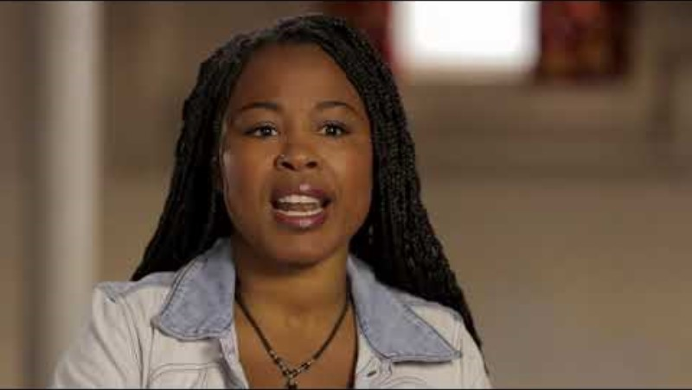
Anthony’s Story
Notes:
Optional: play Anthony’s video to show the impact of tissue donation

Slide 13
Thank you!
Life-Source.org

